Slide 1
LESSON 1/Introduction, Part 1
Communication with
People Around the World
Oral Introduction
Keywords
Warm-up
Flash Card
Text Scroll
Paragraph
Sentence
Phrase
Summary
True or False
Check Your Understanding
Review the Contents
Paragraph Chart

Slide 2

LESSON 1/Introduction/Oral Introduction
Oral Introduction

Slide 3


LESSON 1/Introduction/Oral Introduction
あいさつはコミュニケーションの第一歩だといわれます．
よりよいコミュニケーションをとるためにはどうしたらよいでしょうか．

Slide 4
LESSON 1/Introduction/Oral Introduction
What do you say when you greet your friends, teachers, or international students? In everyday life, daily phrases including greetings are very important for our communication. You should learn common greetings to start good communication. But communication is more than just learning daily phrases. You need to understand the situation well.

Slide 5
LESSON 1/Introduction/Keywords
Keywords

Slide 6

LESSON 1/Introduction/Keywords
culture
phrase
exchange
communication
What do you say when you meet somebody for the first time? You say, “はじめまして” or “よろしく” in Japanese. In other cultures, they use different phrases, but all of us say something to each other. We exchange greetings. Greetings are the good start of communication. Look at the photo on this page. They are doing high five. “High five” is an English phrase. Do you know the Japanese phrase for it?

Slide 7
LESSON 1/Introduction/Warm-up
Warm-up

Slide 8

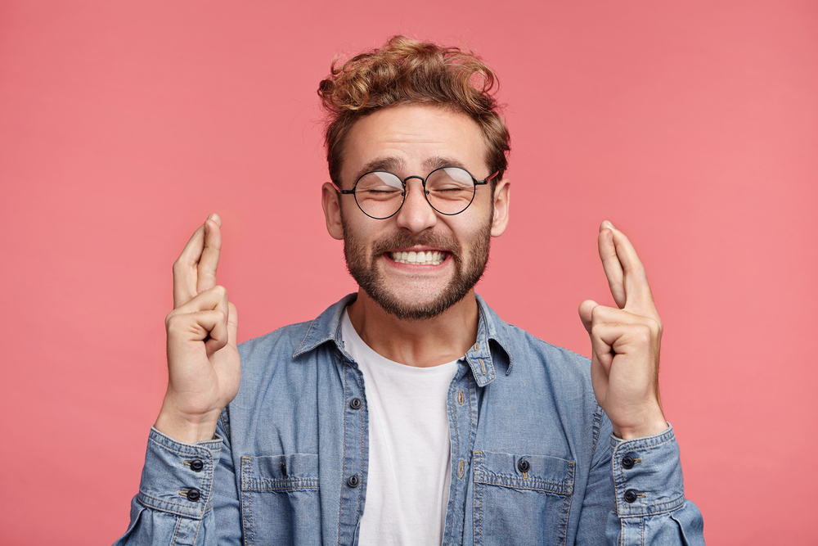


LESSON 1/Introduction/Warm-up
1. A ～ Dのジェスチャーはどういう意味だと思いますか．予想しましょう．
A
B
C
D
Great!（いいね） / Good luck!（幸運を祈ります） / I don’t know.（知らないなぁ） /
Come over here.（こっちへ来て）

Slide 9

LESSON 1/Introduction/Warm-up
2. 音声を聞いて，答えを確かめましょう．
A
This gesture means “I don’t know.” For example, you use it when you don’t know the answer to a question.
Answer（ ）
I don’t know.

Slide 10
LESSON 1/Introduction/Warm-up
2. 音声を聞いて，答えを確かめましょう．
This gesture means “Good luck!” For example, you use it when you wish your friend good luck on a test.
B
Answer（ ）
Good luck!

Slide 11
LESSON 1/Introduction/Warm-up
2. 音声を聞いて，答えを確かめましょう．
C
This gesture means “Come over here.” You use it when you want someone to come to you.
Answer（ ）
Come over here.

Slide 12
LESSON 1/Introduction/Warm-up
2. 音声を聞いて，答えを確かめましょう．
D
This gesture means “Great!” For example, you use it when you want to show you are very happy about something.
Answer（ ）
Great!

Slide 13
LESSON 1/Part 1/Flash Card
Flash Card

Slide 14
essential

Slide 15
不可欠な

Slide 16


Slide 17
assist

Slide 18
～を助ける

Slide 19


Slide 20
correctly

Slide 21
正確に

Slide 22


Slide 23
LESSON 1/Part 1/Text Scroll
Text Scroll

Slide 24

LESSON 1/Part 1/Text Scroll
“Hello, it’s nice to meet you.” “Hey, good to see you.” “Good morning, how are you?” “What’s new?” “How’s it going?” You exchange greetings with other people every day, don’t you? Greetings are the first step to good communication.
Not just greetings but also daily phrases, such as “Thank you,” “Please,” and “Sorry,” are essential. They can assist our communication.
Every language has its own daily phrases. Then, can we always translate a phrase correctly into another language? Let’s take a look at a common Japanese phrase, “Sumimasen.”

Slide 25
LESSON 1/Part 1/Paragraph
Paragraph

Slide 26
LESSON 1/Part 1/Paragraph
“Hello, it’s nice to meet you.” “Hey, good to see you.” “Good morning, how are you?” “What’s new?” “How’s it going?” You exchange greetings with other people every day, don’t you? Greetings are the first step to good communication.

Slide 27
LESSON 1/Part 1/Paragraph
Not just greetings but also daily phrases, such as “Thank you,” “Please,” and “Sorry,” are essential. They can assist our communication.

Slide 28
LESSON 1/Part 1/Paragraph
Every language has its own daily phrases. Then, can we always translate a phrase correctly into another language? Let’s take a look at a common Japanese phrase, “Sumimasen.”

Slide 29
LESSON 1/Part 1/Sentence
Sentence

Slide 30
LESSON 1/Part 1/Sentence
“Hello, it’s nice to meet you.”

Slide 31
LESSON 1/Part 1/Sentence
“Hey, good to see you.”

Slide 32
LESSON 1/Part 1/Sentence
“Good morning, how are you?”

Slide 33
LESSON 1/Part 1/Sentence
“What’s new?”

Slide 34
LESSON 1/Part 1/Sentence
“How’s it going?”

Slide 35
LESSON 1/Part 1/Sentence
You exchange greetings with other people
every day, don’t you?

Slide 36
LESSON 1/Part 1/Sentence
Greetings are the first step to good
communication.

Slide 37
LESSON 1/Part 1/Sentence
Not just greetings but also daily phrases,
such as “Thank you,” “Please,” and “Sorry,”
are essential.

Slide 38
LESSON 1/Part 1/Sentence
They can assist our communication.

Slide 39
LESSON 1/Part 1/Sentence
Every language has its own daily phrases.

Slide 40
LESSON 1/Part 1/Sentence
Then, can we always translate a phrase
correctly into another language?

Slide 41
LESSON 1/Part 1/Sentence
Let’s take a look at a common Japanese
phrase, “Sumimasen.”

Slide 42
LESSON 1/Part 1/Phrase
Phrase

Slide 43


LESSON 1/Part 1/Phrase
“Hello, it’s nice to meet you.”
/
「こんにちは はじめまして」

Slide 44
LESSON 1/Part 1/Phrase
/
“Hey, good to see you.”
「やあ 会えてうれしいよ」

Slide 45
LESSON 1/Part 1/Phrase
/
“Good morning, how are you?”
「おはよう 元気？」

Slide 46
LESSON 1/Part 1/Phrase
“What’s new?”
「最近どう？」

Slide 47
LESSON 1/Part 1/Phrase
“How’s it going?”
「調子はどう？」

Slide 48
LESSON 1/Part 1/Phrase
You exchange greetings with other people
every day, don’t you?
/
/
あなたはあいさつをかわします ほかの人たちと
/
毎日 そうですね

Slide 49
LESSON 1/Part 1/Phrase
Greetings are the first step
to good communication.
/
あいさつは第一歩です
よいコミュニケーションへの

Slide 50
LESSON 1/Part 1/Phrase
/
/
Not just greetings but also daily phrases,
such as “Thank you,” “Please,” and “Sorry,”
are essential.
あいさつだけでなく 日常表現も
/
たとえば「ありがとう」「どうぞ」「すみません」のような
不可欠です

Slide 51
LESSON 1/Part 1/Phrase
They can assist our communication.
それらの言葉は私たちのコミュニケーションを手助けすることができます

Slide 52
LESSON 1/Part 1/Phrase
Every language has its own daily phrases.
/
どの言語にも 独自の日常表現があります

Slide 53
LESSON 1/Part 1/Phrase
/
Then, can we always translate a phrase
correctly into another language?
では 私たちはいつでもある表現を正確に翻訳できるのでしょうか
/
ほかの言語に

Slide 54
LESSON 1/Part 1/Phrase
/
Let’s take a look at a common Japanese phrase,
“Sumimasen.”
見てみましょう よくある日本語の表現「すみません」を

Slide 55
LESSON 1/Part 1/Summary
Summary

Slide 56
LESSON 1/Part 1/Summary

Slide 57
LESSON 1/Part 1/Summary
We say, “How are you?” “Nice to meet you,” “What’s new?” and so on when we exchange greetings. They are the first step to good communication, and they can assist our communication. Take “Sumimasen” for example, and you will know it is not easy to translate our daily phrases.

Slide 58
LESSON 1/Part 1/True or False
True or False

Slide 59
LESSON 1/Part 1/True or False
True or False ①
Greetings are the first step to good
communication.
Answer（ ）
T

Slide 60
LESSON 1/Part 1/True or False
True or False ②
“Thank you,” “Please,” and “Sorry” are
essential daily phrases.
Answer（ ）
T

Slide 61
LESSON 1/Part 1/True or False
True or False ③
Every language has the same daily phrases.
F
Answer（ ）

Slide 62
LESSON 1/Part 1/Check Your Understanding
Check Your Understanding

Slide 63
LESSON 1/Part 1/Check Your Understanding
ペアになって，本文の内容について質問しあいましょう． ①
What are greetings?
They are the first step to good communication.

Slide 64
LESSON 1/Part 1/Check Your Understanding
ペアになって，本文の内容について質問しあいましょう． ②
What can daily phrases assist?
They can assist our communication.

Slide 65
LESSON 1/Part 1/Check Your Understanding
ペアになって，本文の内容について質問しあいましょう． ③
Does every language have its own daily phrases?
Yes, it does.

Slide 66
LESSON 1/Part 1/Review the Contents
Review the Contents

Slide 67
LESSON 1/Part 1/Review the Contents
本文に出てきたあいさつとフレーズを，表の中に入れましょう．
greetings
・“Hello, it’s nice to meet you.”
・“Hey, good to see you.”
・“Good morning, how are you?”
・“What’s new?”
・“How’s it going?”

Slide 68
LESSON 1/Part 1/Review the Contents
本文に出てきたあいさつとフレーズを，表の中に入れましょう．
daily phrases
・“Thank you.”
・“Please.”
・“Sorry.”

Slide 69
LESSON 1/Part 1/Paragraph Chart
Paragraph Chart

Slide 70



LESSON 1/Part 1/Paragraph Chart
daily phrases
Every language has its own ( ).
They can assist ( ).
”Hello, it’s nice to meet you.” ……Greeting
⇒ ( ) to good communication
”Thank you” “Please” ……( )
⇒ essential to good communication
our communication
Ｔhe first step
Daily phrases

Slide 71
LESSON 1/Part 1/Paragraph Chart
どの言語にも日常的なフレーズがある。
私たちのコミュニケーションをサポートしてくれる。
「こんにちは、はじめまして」 ・・・・・ 挨拶
⇒良好なコミュニケーションの第一歩
「ありがとう」「お願いします」 ・・・・・ 日常会話フレーズ
⇒コミュニケーションを円滑にするために欠かせない

