Slide 1
LESSON 1/Introduction, Part 1
Communication with
People Around the World
Oral Introduction
Warm-up
Flash Card
Text Scroll
Paragraph
Sentence
Phrase
Summary
True or False
Comprehension [1]
Comprehension [2]
Paragraph Chart

Slide 2

LESSON 1/Introduction/Oral Introduction
Oral Introduction

Slide 3


LESSON 1/Introduction/Oral Introduction
あいさつはコミュニケーションの第一歩だといわれます．
よりよいコミュニケーションをとるためにはどうしたらよいでしょうか．

Slide 4
LESSON 1/Introduction/Oral Introduction
What do you say when you greet your friends, teachers, or international students? In everyday life, daily phrases including greetings are very important for our communication. You should learn common greetings to start good communication. But communication is more than just learning daily phrases. You need to understand the situation well.

Slide 5
LESSON 1/Introduction/Warm-up
Warm-up

Slide 6

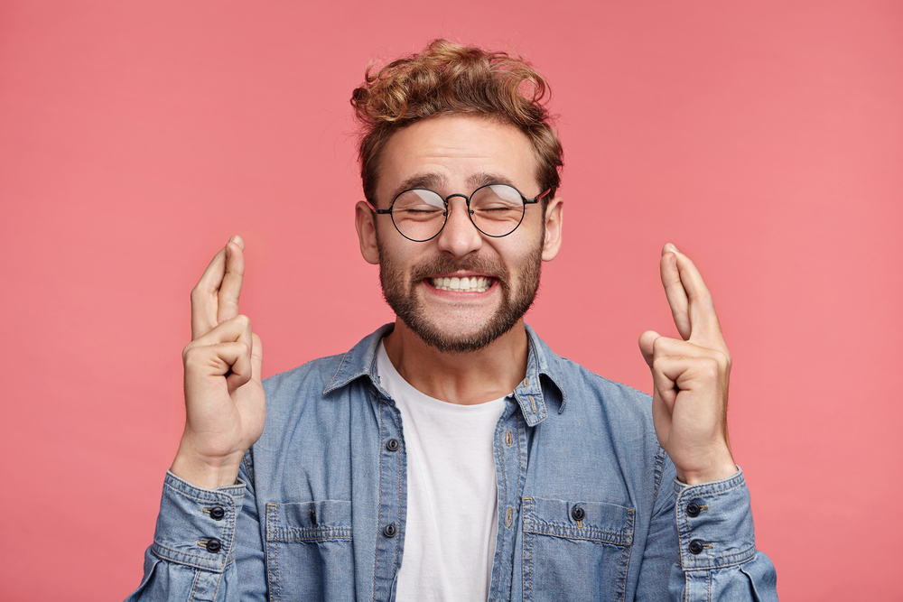


LESSON 1/Introduction/Warm-up
1. A ～ Dのジェスチャーはどういう意味だと思いますか．予想しましょう．
A
B
C
D
Great!（いいね） / Good luck!（幸運を祈ります） / I don’t know.（知らないなぁ） /
Come over here.（こっちへ来て）

Slide 7


LESSON 1/Introduction/Warm-up
2. 音声を聞いて，答えを確かめましょう．
A
This gesture means “I don’t know.” For example, you use it when you don’t know the answer to a question.
Answer（ ）
I don’t know.

Slide 8
LESSON 1/Introduction/Warm-up
2. 音声を聞いて，答えを確かめましょう．
This gesture means “Good luck!” For example, you use it when you wish your friend good luck on a test.
B
Answer（ ）
Good luck!

Slide 9
LESSON 1/Introduction/Warm-up
2. 音声を聞いて，答えを確かめましょう．
C
This gesture means “Come over here.” You use it when you want someone to come to you.
Answer（ ）
Come over here.

Slide 10
LESSON 1/Introduction/Warm-up
2. 音声を聞いて，答えを確かめましょう．
D
This gesture means “Great!” For example, you use it when you want to show you are very happy about something.
Answer（ ）
Great!

Slide 11
LESSON 1/Part 1/Flash Card
Flash Card

Slide 12
essential

Slide 13
不可欠な

Slide 14


Slide 15
assist

Slide 16
～を助ける

Slide 17


Slide 18
correctly

Slide 19
正確に

Slide 20


Slide 21
LESSON 1/Part 1/Text Scroll
Text Scroll

Slide 22

LESSON 1/Part 1/Text Scroll
“Hello, it’s nice to meet you.” “Hey, good to see you.” “Good morning, how are you?” “What’s new?” “How’s it going?” You exchange greetings with other people every day, don’t you? Greetings are the first step to good communication.
Not just greetings but also daily phrases, such as “Thank you,” “Please,” and “Sorry,” are essential. They can assist our communication.
Every language has its own daily phrases. Then, can we always translate a phrase correctly into another language? Let’s take a look at a common Japanese phrase, “Sumimasen.”

Slide 23
LESSON 1/Part 1/Paragraph
Paragraph

Slide 24
LESSON 1/Part 1/Paragraph
“Hello, it’s nice to meet you.” “Hey, good to see you.” “Good morning, how are you?” “What’s new?” “How’s it going?” You exchange greetings with other people every day, don’t you? Greetings are the first step to good communication.

Slide 25
LESSON 1/Part 1/Paragraph
Not just greetings but also daily phrases, such as “Thank you,” “Please,” and “Sorry,” are essential. They can assist our communication.

Slide 26
LESSON 1/Part 1/Paragraph
Every language has its own daily phrases. Then, can we always translate a phrase correctly into another language? Let’s take a look at a common Japanese phrase, “Sumimasen.”

Slide 27
LESSON 1/Part 1/Sentence
Sentence

Slide 28
LESSON 1/Part 1/Sentence
“Hello, it’s nice to meet you.”

Slide 29
LESSON 1/Part 1/Sentence
“Hey, good to see you.”

Slide 30
LESSON 1/Part 1/Sentence
“Good morning, how are you?”

Slide 31
LESSON 1/Part 1/Sentence
“What’s new?”

Slide 32
LESSON 1/Part 1/Sentence
“How’s it going?”

Slide 33
LESSON 1/Part 1/Sentence
You exchange greetings with other people
every day, don’t you?

Slide 34
LESSON 1/Part 1/Sentence
Greetings are the first step to good
communication.

Slide 35
LESSON 1/Part 1/Sentence
Not just greetings but also daily phrases,
such as “Thank you,” “Please,” and “Sorry,”
are essential.

Slide 36
LESSON 1/Part 1/Sentence
They can assist our communication.

Slide 37
LESSON 1/Part 1/Sentence
Every language has its own daily phrases.

Slide 38
LESSON 1/Part 1/Sentence
Then, can we always translate a phrase
correctly into another language?

Slide 39
LESSON 1/Part 1/Sentence
Let’s take a look at a common Japanese
phrase, “Sumimasen.”

Slide 40
LESSON 1/Part 1/Phrase
Phrase

Slide 41


LESSON 1/Part 1/Phrase
“Hello, it’s nice to meet you.”
/
「こんにちは はじめまして」

Slide 42
LESSON 1/Part 1/Phrase
/
“Hey, good to see you.”
「やあ 会えてうれしいよ」

Slide 43
LESSON 1/Part 1/Phrase
/
“Good morning, how are you?”
「おはよう 元気？」

Slide 44
LESSON 1/Part 1/Phrase
“What’s new?”
「最近どう？」

Slide 45
LESSON 1/Part 1/Phrase
“How’s it going?”
「調子はどう？」

Slide 46
LESSON 1/Part 1/Phrase
You exchange greetings with other people
every day, don’t you?
/
/
あなたはあいさつをかわします ほかの人たちと
/
毎日 そうですね

Slide 47
LESSON 1/Part 1/Phrase
Greetings are the first step
to good communication.
/
あいさつは第一歩です
よいコミュニケーションへの

Slide 48
LESSON 1/Part 1/Phrase
/
/
Not just greetings but also daily phrases,
such as “Thank you,” “Please,” and “Sorry,”
are essential.
あいさつだけでなく 日常表現も
/
たとえば「ありがとう」「どうぞ」「すみません」のような
不可欠です

Slide 49
LESSON 1/Part 1/Phrase
They can assist our communication.
それらの言葉は私たちのコミュニケーションを手助けすることができます

Slide 50
LESSON 1/Part 1/Phrase
Every language has its own daily phrases.
/
どの言語にも 独自の日常表現があります

Slide 51
LESSON 1/Part 1/Phrase
/
Then, can we always translate a phrase
correctly into another language?
では 私たちはいつでもある表現を正確に翻訳できるのでしょうか
/
ほかの言語に

Slide 52
LESSON 1/Part 1/Phrase
/
Let’s take a look at a common Japanese phrase,
“Sumimasen.”
見てみましょう よくある日本語の表現「すみません」を

Slide 53
LESSON 1/Part 1/Summary
Summary

Slide 54
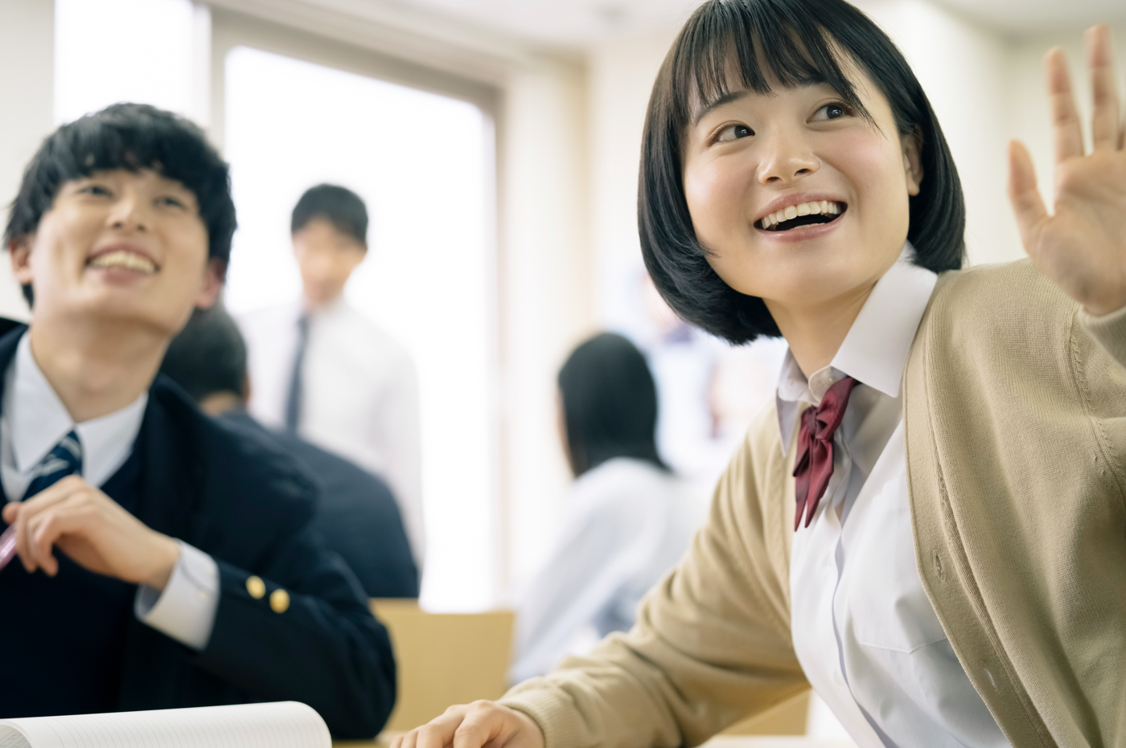
LESSON 1/Part 1/Summary

Slide 55
LESSON 1/Part 1/Summary
We say, “How are you?” “Nice to meet you,” “What’s new?” and so on when we exchange greetings. They are the first step to good communication, and they can assist our communication. Take “Sumimasen” for example, and you will know it is not easy to translate our daily phrases.

Slide 56
LESSON 1/Part 1/True or False
True or False

Slide 57
LESSON 1/Part 1/True or False
True or False ①
Greetings are the first step to good
communication.
Answer（ ）
T

Slide 58
LESSON 1/Part 1/True or False
True or False ②
“Thank you,” “Please,” and “Sorry” are
essential daily phrases.
Answer（ ）
T

Slide 59
LESSON 1/Part 1/True or False
True or False ③
Every language has the same daily phrases.
F
Answer（ ）

Slide 60
LESSON 1/Part 1/Comprehension [1]
Comprehension [1]

Slide 61
LESSON 1/Part 1/Comprehension [1]
ペアになって，本文の内容について質問しあいましょう． ①
What are greetings?
They are the first step to good communication.

Slide 62
LESSON 1/Part 1/Comprehension [1]
ペアになって，本文の内容について質問しあいましょう． ②
What can daily phrases assist?
They can assist our communication.

Slide 63
LESSON 1/Part 1/Comprehension [1]
ペアになって，本文の内容について質問しあいましょう． ③
Does every language have its own daily phrases?
Yes, it does.

Slide 64
LESSON 1/Part 1/Comprehension [2]
Comprehension [2]

Slide 65
LESSON 1/Part 1/Comprehension [2]
本文に出てきたあいさつとフレーズを，表の中に入れましょう．
greetings
・“Hello, it’s nice to meet you.”
・“Hey, good to see you.”
・“Good morning, how are you?”
・“What’s new?”
・“How’s it going?”

Slide 66
LESSON 1/Part 1/Comprehension [2]
本文に出てきたあいさつとフレーズを，表の中に入れましょう．
daily phrases
・“Thank you.”
・“Please.”
・“Sorry.”

Slide 67
LESSON 1/Part 1/Paragraph Chart
Paragraph Chart

Slide 68



LESSON 1/Part 1/Paragraph Chart
daily phrases
Every language has its own ( ).
They can assist ( ).
”Hello, it’s nice to meet you.” ……Greeting
⇒ ( ) to good communication
”Thank you” “Please” ……( )
⇒ essential to good communication
our communication
Ｔhe first step
Daily phrases

Slide 69
LESSON 1/Part 1/Paragraph Chart
どの言語にも日常的なフレーズがある。
私たちのコミュニケーションをサポートしてくれる。
「こんにちは、はじめまして」 ・・・・・ 挨拶
⇒良好なコミュニケーションの第一歩
「ありがとう」「お願いします」 ・・・・・ 日常会話フレーズ
⇒コミュニケーションを円滑にするために欠かせない

