Slide 1
LESSON 1/Introduction, Part 1
Communication with
People Around the World
Oral Introduction
Warm-up
イントロ動画
（AI）
IDIOM
トレーニング
本文PDF
不規則動詞
変化表
Flashcards
Small Talk
新出語 英英
Text Scroll
Paragraph
Sentence
Phrase
導入写真
補充問題
本文
補充問題
Summary
True or False
What is the topic?
Paragraph Chart
パラフレーズ
（AI）
Comprehension 【１】
Comprehension 【２】
Grammar
Think and Share!

Slide 2

LESSON 1/Introduction/Oral Introduction
Oral Introduction

Slide 3


LESSON 1/Introduction/Oral Introduction
あいさつはコミュニケーションのはじめの一歩です．
よりよいコミュニケーションをとるために、どのようなことに気をつければよいでしょうか．

Slide 4
LESSON 1/Introduction/Oral Introduction
What do you say when you greet your friends, teachers, or international students? In everyday life, greetings and daily phrases are very important for communication. You should learn basic greetings to build good communication. However, communication is more than just learning daily phrases. You also need to understand the different cultures.

Slide 5
LESSON 1/Introduction/Warm-up
Warm-up

Slide 6

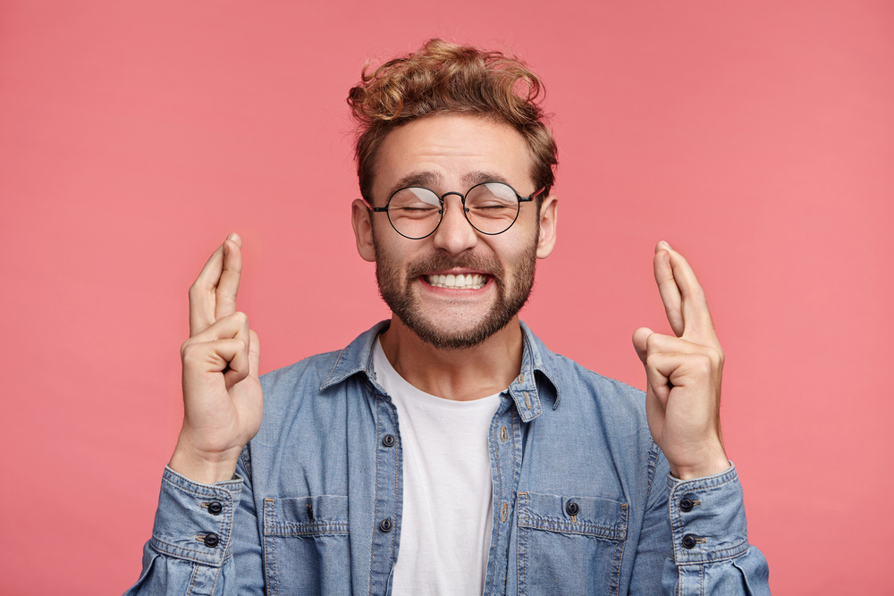


LESSON 1/Introduction/Warm-up
1. Listen and choose the correct meaning for each picture.
A
B
C
D
Good luck! / Good job! / I don’t know. / Come over here.

Slide 7



LESSON 1/Introduction/Warm-up
1. Listen and choose the correct meaning for each picture.
A
This gesture means “I don’t know.” For example, you use it when you don’t know the answer to a question.
Answer（ ）
I don’t know.

Slide 8
LESSON 1/Introduction/Warm-up
1. Listen and choose the correct meaning for each picture.
This gesture means “Good luck!” For example, you use it when you wish your friend good luck on a test.
B
Answer（ ）
Good luck!

Slide 9
LESSON 1/Introduction/Warm-up
1. Listen and choose the correct meaning for each picture.
C
This gesture means “Come over here.” You use it when you want someone to come to you.
Answer（ ）
Come over here.

Slide 10
LESSON 1/Introduction/Warm-up
1. Listen and choose the correct meaning for each picture.
D
This gesture means “Good job!” For example, you use it when you show that you are very happy about someone’s work.
Answer（ ）
Good job!

Slide 11
LESSON 1/Introduction/Warm-up
2. Pair up and ask each other the following questions.
Which of the gestures above do you see?
I see gesture D. It is the gesture our teacher makes when we give the right answers to her questions.

Slide 12
LESSON 1/Introduction/Warm-up
What gestures do we usually use in our daily lives?
We usually wave our hands when we say goodbye.

Slide 13
LESSON 1/Part 1/Flashcards
Flashcards

Slide 14
動
exchange

Slide 15

動

Slide 16
動
～を交換する

Slide 17
名
greeting

Slide 18

名

Slide 19
名
あいさつ

Slide 20
名
phrase

Slide 21

名

Slide 22
名
言い回し，表現

Slide 23

動
excuse

Slide 24

動

Slide 25
動
～を許す，
～の言い訳をする

Slide 26

形
essential

Slide 27

形

Slide 28
形
不可欠な

Slide 29

動
assist

Slide 30

動

Slide 31
動
～を助ける

Slide 32

動
translate

Slide 33

動

Slide 34
動
…を翻訳する

Slide 35
LESSON 1/Part 1/Text Scroll
Text Scroll

Slide 36

LESSON 1/Part 1/Text Scroll
“Hello, it’s nice to see you.” “Good morning, how are you?” “What’s new?” You exchange greetings with other people every day, don’t you? Greetings are the first step in good communication.
Not just greetings but also daily phrases, such as “Thank you,” “Excuse me,” and “I’m sorry,” are essential. They can assist our communication.
Every language has its own daily phrases. But can we always translate a phrase correctly into another language? Let’s take a look at a common Japanese phrase “Sumimasen.”

Slide 37
LESSON 1/Part 1/Paragraph
Paragraph

Slide 38
LESSON 1/Part 1/Paragraph
“Hello, it’s nice to see you.” “Good morning, how are you?” “What’s new?” You exchange greetings with other people every day, don’t you? Greetings are the first step in good communication.

Slide 39
LESSON 1/Part 1/Paragraph
Not just greetings but also daily phrases, such as “Thank you,” “Excuse me,” and “I’m sorry,” are essential. They can assist our communication.

Slide 40
LESSON 1/Part 1/Paragraph
Every language has its own daily phrases. But can we always translate a phrase correctly into another language? Let’s take a look at a common Japanese phrase “Sumimasen.”

Slide 41
LESSON 1/Part 1/Sentence
Sentence

Slide 42
LESSON 1/Part 1/Sentence
“Hello, it’s nice to see you.”

Slide 43
LESSON 1/Part 1/Sentence
“Good morning, how are you?”

Slide 44
LESSON 1/Part 1/Sentence
“What’s new?”

Slide 45
LESSON 1/Part 1/Sentence
You exchange greetings with other people every day, don’t you?

Slide 46
LESSON 1/Part 1/Sentence
Greetings are the first step in good communication.

Slide 47
LESSON 1/Part 1/Sentence
Not just greetings but also daily phrases, such as “Thank you,” “Excuse me,” and “I’m sorry,” are essential.

Slide 48
LESSON 1/Part 1/Sentence
They can assist our communication.

Slide 49
LESSON 1/Part 1/Sentence
Every language has its own daily phrases.

Slide 50
LESSON 1/Part 1/Sentence
But can we always translate a phrase correctly into another language?

Slide 51
LESSON 1/Part 1/Sentence
Let’s take a look at a common Japanese phrase “Sumimasen.”

Slide 52
LESSON 1/Part 1/Phrase
Phrase

Slide 53



LESSON 1/Part 1/Phrase
“Hello,
it’s nice to see you.”
/
「こんにちは
はじめまして」

Slide 54
LESSON 1/Part 1/Phrase
/
“Good morning,
how are you?”
「おはよう
元気?」

Slide 55
LESSON 1/Part 1/Phrase
“What’s new?”
「最近どう？」

Slide 56
LESSON 1/Part 1/Phrase
/
You exchange greetings
with other people
every day,
don’t you?
あなたはあいさつをかわします
/
ほかの人たちと
/
毎日
そうですね

Slide 57
LESSON 1/Part 1/Phrase
/
Greetings are the first step
in good communication.
あいさつは第一歩です
よいコミュニケーションにおける

Slide 58
LESSON 1/Part 1/Phrase
/
Not just greetings
but also daily phrases,
such as “Thank you,” “Excuse me,” and “I’m sorry,
are essential.
あいさつだけでなく
/
日常表現も
/
たとえば「ありがとう」「失礼します」「すみません」のような
不可欠です

Slide 59
LESSON 1/Part 1/Phrase
They can assist our communication.
それら（のことば）は私たちのコミュニケーションを手助けすることができます

Slide 60
LESSON 1/Part 1/Phrase
Every language
has its own daily phrases.
/
どの言語にも
独自の日常表現があります

Slide 61
LESSON 1/Part 1/Phrase
/
But can we always translate a phrase correctly
into another language?
しかし，いつでもある表現を正確に翻訳できるでしょうか
ほかの言語に

Slide 62
LESSON 1/Part 1/Phrase
/
Let’s take a look
at a common Japanese phrase “Sumimasen.”
見てみましょう
よくある日本語の表現「すみません」を

Slide 63
LESSON 1/Part 1/Summary
Summary

Slide 64
LESSON 1/Part 1/Summary

Slide 65
LESSON 1/Part 1/Summary
We say, “Hello, it’s nice to see you,” “Good morning, how are you?” and so on when exchanging greetings with other people. They are the first step in good communication. Daily phrases, such as “Thank you,” and “Excuse me,” can also assist our communication. Every language has its own daily phrases. Let’s look at “Sumimasen” for example.

Slide 66
LESSON 1/Part 1/True or False
True or False

Slide 67
LESSON 1/Part 1/True or False
True or False ①
Greetings are the first step in good communication.
Answer（ ）
T

Slide 68
LESSON 1/Part 1/True or False
True or False ②
“Thank you,” “Excuse me,” and “I’m sorry” are essential daily phrases.
Answer（ ）
T

Slide 69
LESSON 1/Part 1/True or False
True or False ③
Every language has the same daily phrases.
F
Answer（ ）

Slide 70
LESSON 1/Part 1/What is the topic of the passage?
What is the topic of the passage?

Slide 71
LESSON 1/Part 1/What is the topic of the passage?
What is the topic of the passage?
—It’s about ̠̠ ̠ ̠ ̠ ̠ ̠ ̠ ̠ ̠ ̠ ̠ ̠ ̠ ̠ ̠ ̠ .
essential communication
greetings and daily phrases
a common Japanese phrase
Answer（ ）
b

Slide 72
LESSON 1/Part 1/Paragraph Chart
Paragraph Chart

Slide 73
LESSON 1/Part 1/Paragraph Chart
Greetings and daily phrases
Greetings are the first step in good ( ).
Examples (1) “Hello, it’s nice to see you.”
(2) “Good morning, how are you?”
(3) “What’s ( )?”
Every language has its own ( ).
Examples (1) “Thank you.”
(2) “Excuse me.”
(3) “I’m sorry.”
communication
new
daily phrases

Slide 74
LESSON 1/Part 1/Paragraph Chart
あいさつと日常表現
あいさつは，よいコミュニケーションにおける第一歩です。
例 (1) 「こんにちは，はじめまして」
(2) 「おはよう，元気？」
(3) 「最近どう？」
どの言語にも独自の日常表現があります。
例 (1) 「ありがとう」
(2) 「失礼します」
(3) 「すみません」

Slide 75
LESSON 1/Part 1/Comprehension【１】
Comprehension【１】

Slide 76
LESSON 1/Part 1/Comprehension【１】
Answer the following questions. ①
What are greetings?
—They are the ( ) ( ) in good communication.
first step

Slide 77
LESSON 1/Part 1/Comprehension【１】
Answer the following questions. ②
What can daily phrases assist?
—They can assist ( ) ( ).
our communication

Slide 78
LESSON 1/Part 1/Comprehension【１】
Answer the following questions. ③
Does every language have its own daily phrases?
—( ), it ( ).
Yes does

Slide 79
LESSON 1/Part 1/Comprehension【２】
Comprehension【２】

Slide 80
LESSON 1/Part 1/Comprehension【２】
Fill in the boxes．
Greetings
・Hello, it’s nice to see you.
・Good morning, how are you?
・What’s new?

Slide 81
LESSON 1/Part 1/Comprehension【２】
Fill in the boxes．
Daily phrases
・Thank you.
・Excuse me.
・I’m sorry.

Slide 82
LESSON 1/Part 1/Grammar
Grammar

Slide 83
LESSON 1/Part 1/Grammar
Grammar
主部と述部
「 …が，…は」にあたる部分を主部，「…である，…する」にあたる
部分を述部といいます。主部の中心を主語，述部の中心を（述語） 動詞といいます。
You exchange greetings with other people every day.
主部 述部
（あなたは毎日ほかの人たちとあいさつを交わしますね）

Slide 84
LESSON 1/Part 1/Grammar
Put a slash ( / ) between the subject (主部) and the predicate (述部). Then read each sentence.
/
（1） The smartphone on the table is my elder brother’s.
（2） A little girl in a blue dress danced happily on the stage.
（3） My grandmother and grandfather have been to Norway, Sweden, and Finland.
/
/

Slide 85
LESSON 1/Part 1/Think and Share!
Think and Share!

Slide 86
LESSON 1/Part 1/Think and Share!
本文に関連して、考えたことを共有しましょう．
What kind of greetings did you exchange today? Pair up and say them to each other.
（例）
Good morning. Did you sleep well last night?

Slide 87
LESSON 1/Introduction/イントロ動画(AI)
イントロ動画（AI）

Slide 88
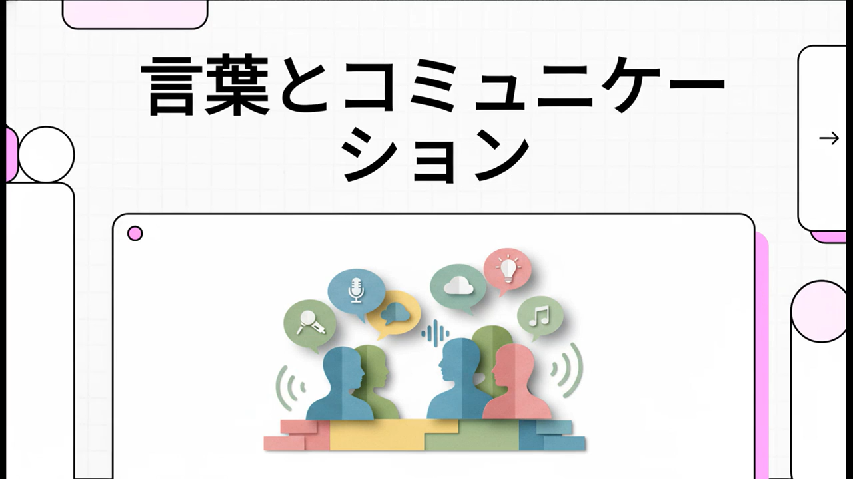
LESSON 1/Introduction/Intro video
（71秒）

Slide 89
LESSON 1/Part 1/本文PDF
本文PDF

Slide 90

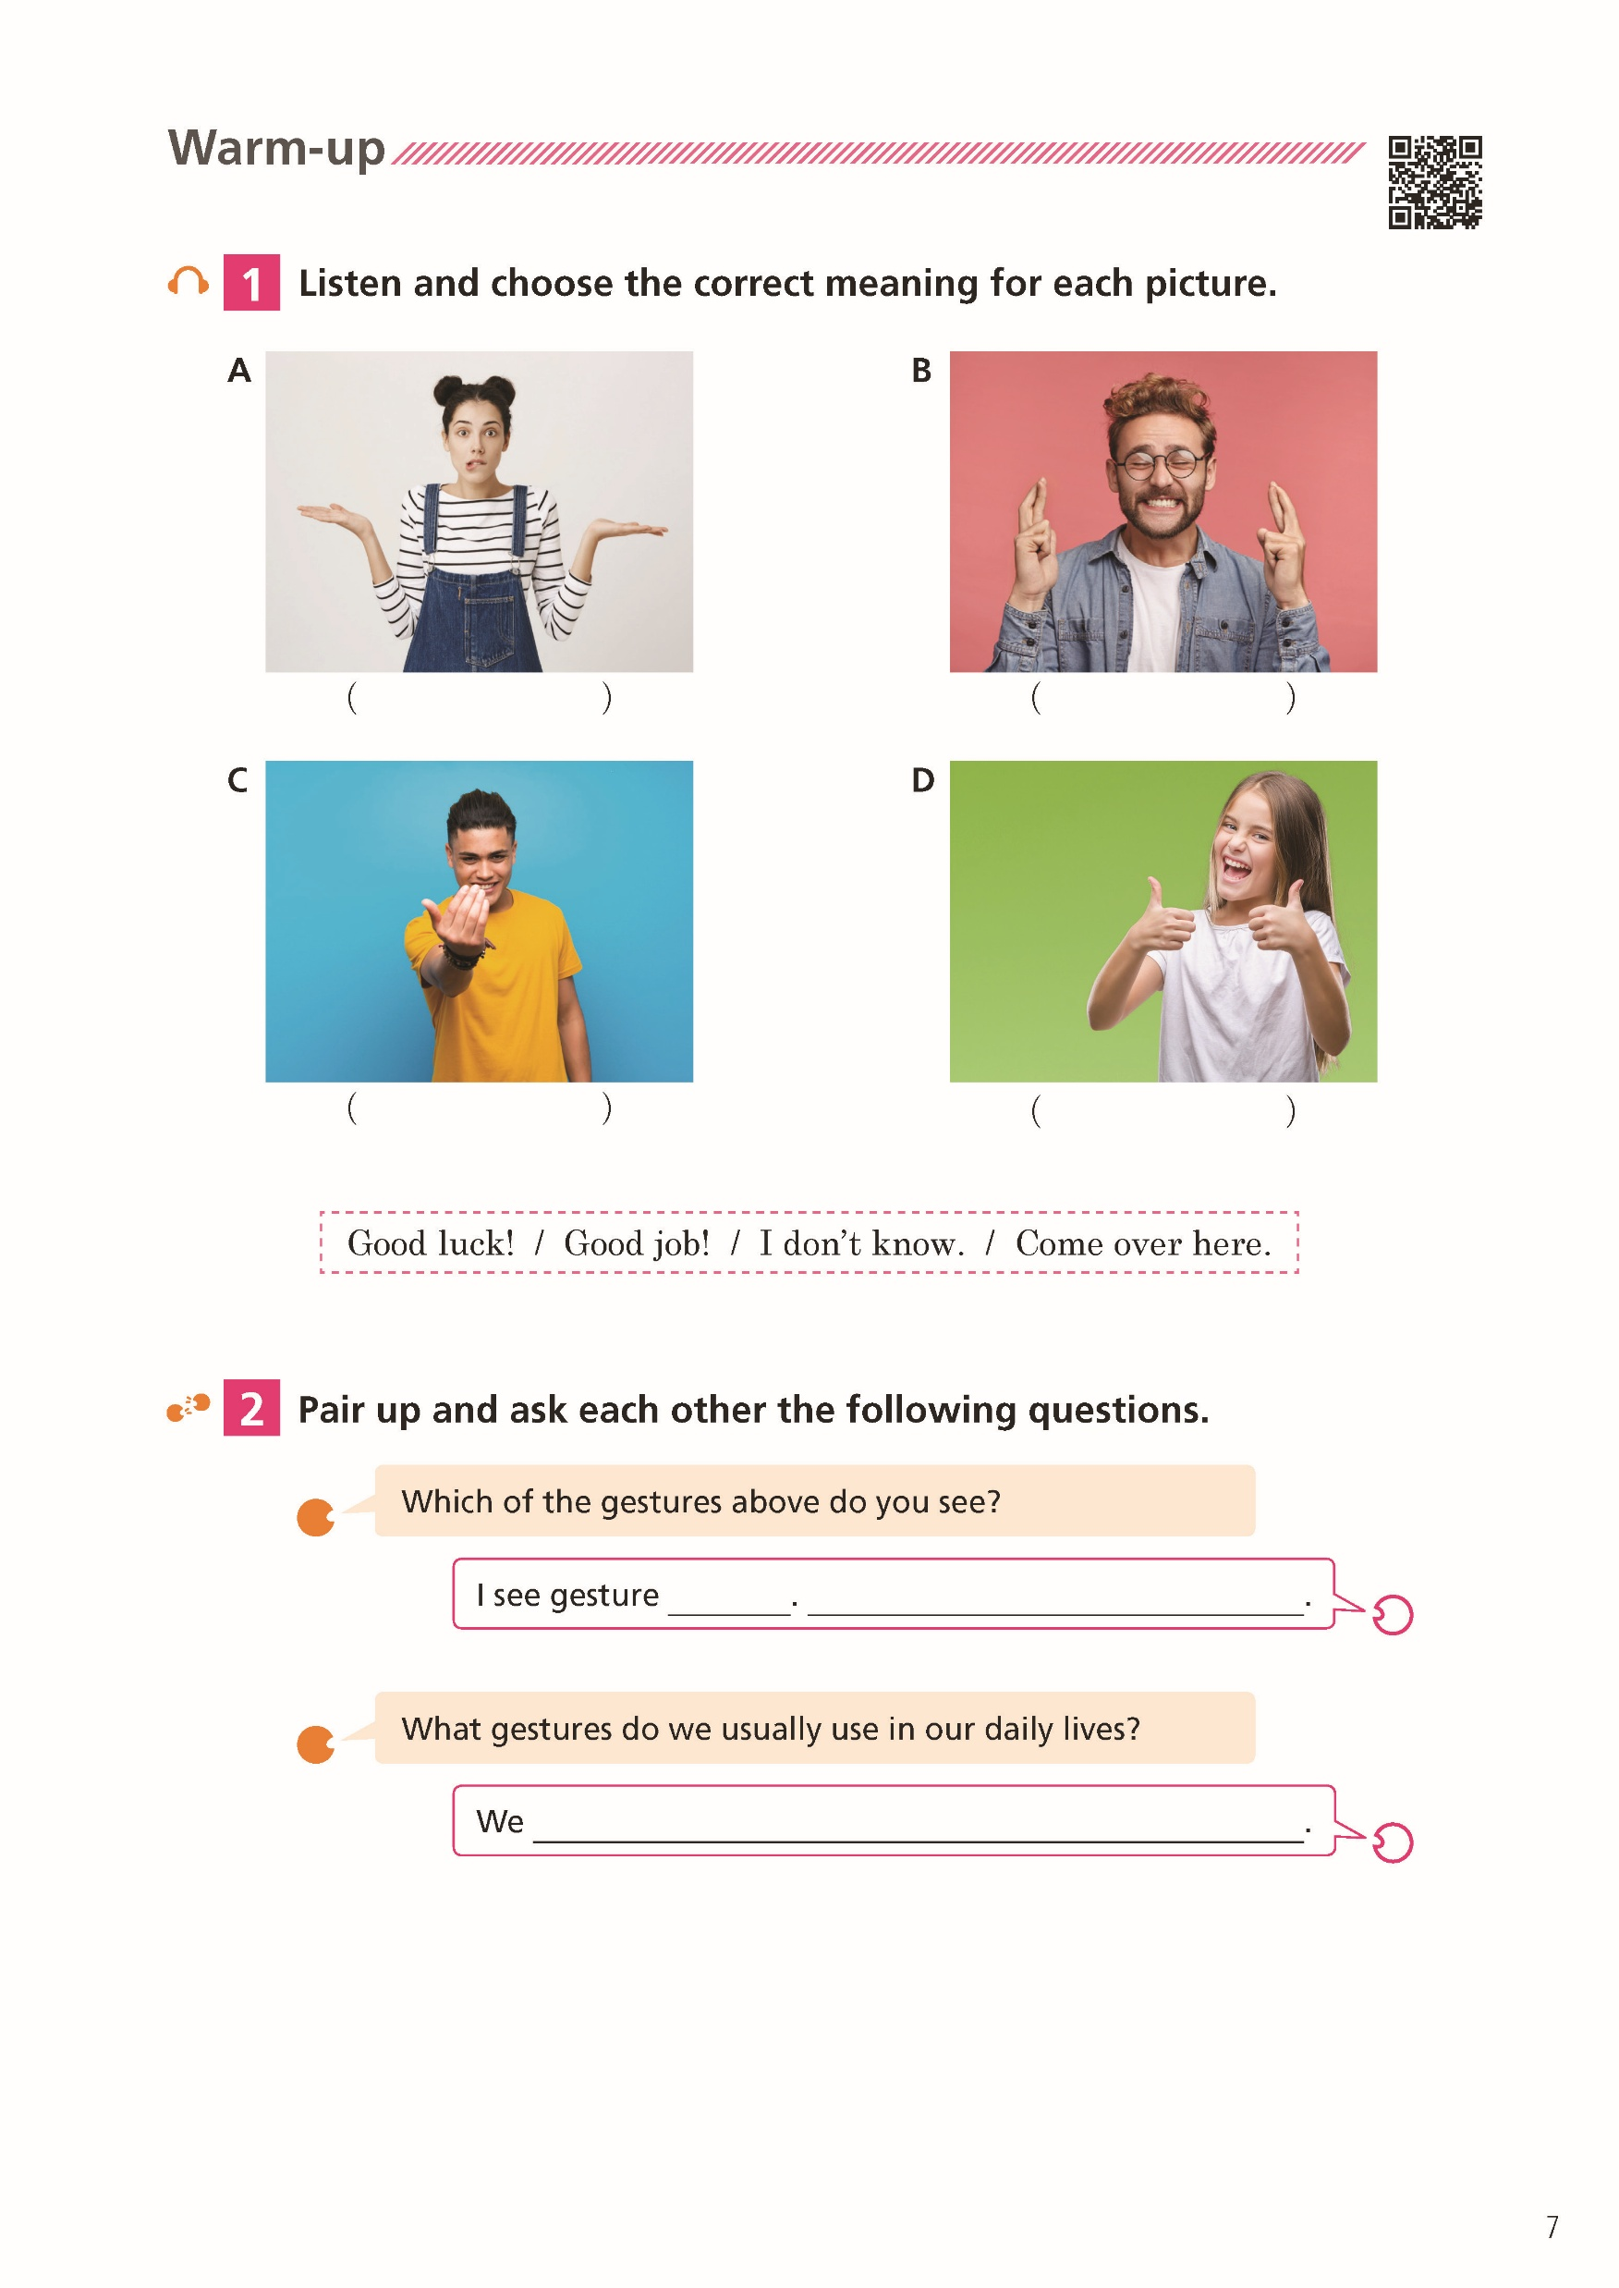

Slide 91
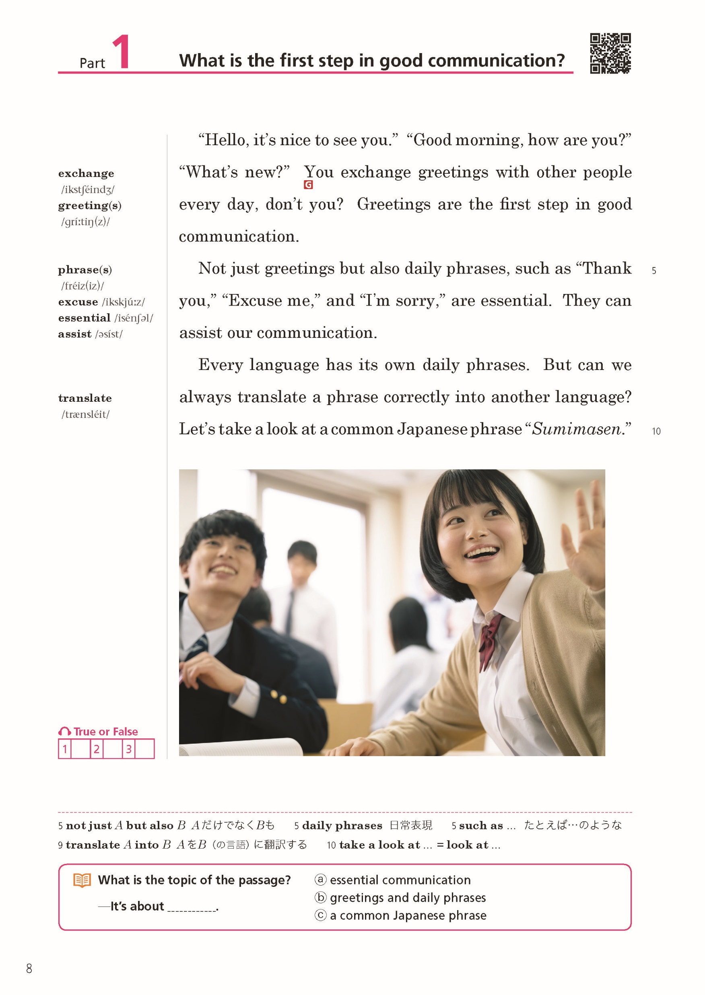
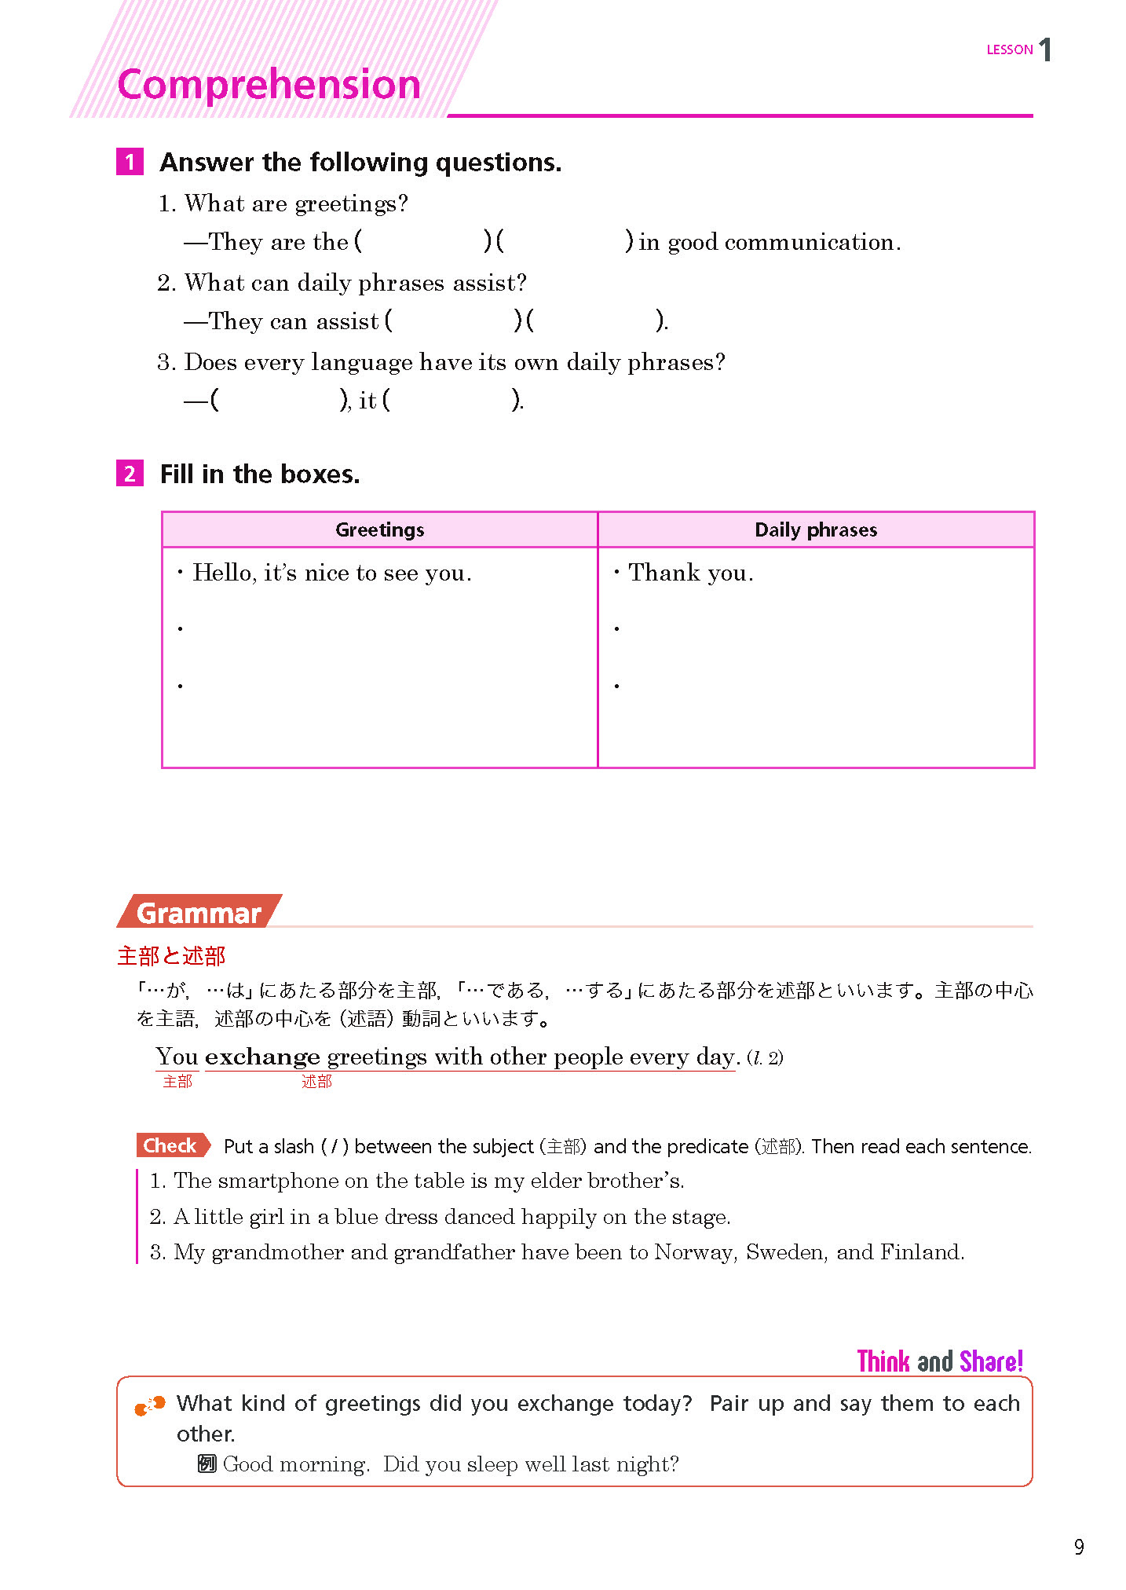

Slide 92
LESSON 1/Part 1/導入写真 補充問題
導入写真 補充問題

Slide 93

LESSON 1/Part 1/導入写真 補充問題
導入写真について，つぎの質問に答えましょう． ①
Where are these students?
They are in the hallway of their school.

Slide 94
LESSON 1/Part 1/導入写真 補充問題
導入写真について，つぎの質問に答えましょう． ②
What are they doing?
They are moving to the next classroom.
They are talking to each other.

Slide 95
LESSON 1/Part 1/導入写真 補充問題
導入写真について，つぎの質問に答えましょう． ③
How do they look?
They look happy[cheerful].

Slide 96
LESSON 1/Part 1/Small Talk
Small Talk

Slide 97
LESSON 1/Part 1/Small Talk
Do you know the “Goo Touch”? It’s when two people touch their fists to express friendship, celebration, or respect. Former US President Barack Obama often used the “Goo Touch.” It can also be seen in professional sports, such as baseball and golf. Due to COVID-19, more and more people began using this gesture instead of handshakes and hugs to prevent the spread of the virus.

Slide 98
LESSON 1/Part 1/Small Talk
Around the world, there are many different greeting styles, such as nose-to-nose touches or sticking out one’s tongue. It would be interesting to learn about the cultures behind these greetings. You never know which greetings might become popular.

Slide 99
LESSON 1/Part 1/パラフレーズ（AI)
パラフレーズ（AI）

Slide 100
LESSON 1/Part 1/パラフレーズ（AI)
What is the first step in good communication?
“Hello, it’s nice to see you.” “Good morning, how are you?” “What’s new?” You greet other people every day, don’t you? Greetings are the first step in good communication.
Not only greetings but also daily expressions, like “Thank you,” “Excuse me,” and “I’m sorry,” are very important.

Slide 101
LESSON 1/Part 1/パラフレーズ（AI)
They help us communicate better.
Every language has its own daily expressions. But can we always translate a phrase correctly into another language? Let’s look at a common Japanese phrase, “Sumimasen.”

Slide 102
LESSON 1/Part 1/本文 補充問題
本文 補充問題

Slide 103
LESSON 1/Part 1/本文 補充問題
本文の内容について，つぎの質問に答えましょう． ①
What do you say, for example, when you exchange greetings?
We say, “Hello, it’s nice to see you,” Good morning, how are you?” “What’s new?” and so on.

Slide 104
LESSON 1/Part 1/本文 補充問題
本文の内容について，つぎの質問に答えましょう． ②
Are greetings the first step in good communication?
Yes, they are.

Slide 105

LESSON 1/Part 1/本文 補充問題
本文の内容について，つぎの質問に答えましょう． ③
What do you say as daily phrases, for example?
We say, “Thank you,” “Excuse me,” and “I’m sorry.”

Slide 106

LESSON 1/Part 1/本文 補充問題
本文の内容について，つぎの質問に答えましょう． ④
What does every language have?
It has its own daily phrases.

Slide 107

LESSON 1/Part 1/本文 補充問題
本文の内容について，つぎの質問に答えましょう． ⑤
Is “Sumimasen” a common Japanese phrase?
Yes, it is.

Slide 108
LESSON 1/Part 1/IDIOMトレーニング
IDIOMトレーニング

Slide 109
LESSON 1/Part 1/IDIOMトレーニング
かっこ内に適当な語を入れましょう．
( ) ( ) students ( ) ( ) teachers enjoyed the school festival.
Not just
but also
生徒たちだけでなく先生方も文化祭を楽しみました。

Slide 110
LESSON 1/Part 1/IDIOMトレーニング
かっこ内に適当な語を入れましょう．
This nature park has wonderful animals, ( ) ( ) elephants and giraffes.
such as
この自然公園にはゾウやキリンなどのすばらしい動物がいます。

Slide 111
LESSON 1/Part 1/IDIOMトレーニング
かっこ内に適当な語を入れましょう．
She has ( ) more than 15 novels ( ) Japanese.
translated
into
彼女は15冊以上の小説を日本語に翻訳しています。

Slide 112
LESSON 1/Part 1/不規則動詞変化表
不規則動詞 変化表

Slide 113
LESSON 1/Part 1/不規則動詞変化表
原形 | 過去形 | 過去分詞形 | ing形 | 型 | 意味
be (is, am, are) |  |  |  |  | …である
see |  |  |  |  | 見る
do |  |  |  |  | する
have |  |  |  |  | もっている
take |  |  |  |  | とる
was, were
been
being
A-B-C
saw
seen
seeing
A-B-C
did
done
doing
A-B-C
had
had
having
A-B-B
took
taken
taking
A-B-C

Slide 114
LESSON 1/Part 1/新出語 英英
新出語 英英

Slide 115
動
to give something and receive something in return

Slide 116
動
exchange

Slide 117
名
word or action used to say hello or welcome someone

Slide 118
名
greeting

Slide 119
名
a group of words that are often used together and have a particular meaning

Slide 120
名
phrase

Slide 121
動
to forgive someone or allow them to do something without punishment or blame

Slide 122
動
excuse

Slide 123
形
absolutely necessary

Slide 124
形
essential

Slide 125
動
to help

Slide 126
動
assist

Slide 127
動
to change words into a different language

Slide 128
動
translate

Slide 129
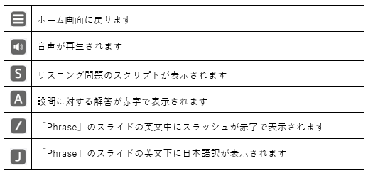
使い方 1/2
本データは，文部科学省検定済教科書「グローブ英語コミュニケーションⅠ」に完全準拠した教材ツールです。
教科書の学習内容の理解をさらに深めるためのデータもあわせて収録されています。
スライドのテキストを加工したり，アニメーション機能を変更したりするなど，自由に編集することができます。
授業に応じて先生がカスタマイズしてご活用ください。
【基本的な使い方】
ツールバー「スライドショー／スライドショーの開始（最初から）」をクリックすると，ホーム画面（もくじページ）が表示されます。
👉 お使いになる学習項目のボタンをクリックすると，当該箇所のトビラページが表示されます。
👉「enter」キー（またはマウスホイール）でつぎのスライドが表示されます。
（「back space」キー（またはマウスホイール）で前のスライドに戻ります。）
👉 授業進行に合わせてスライド上のアイコンをクリックしてください。
【アイコン一覧】

Slide 130
お願い 2/2
文英堂では，本データを先生方にとってより使いやすく充実させるため，
忌憚ないご意見やご感想，アイデアなどをお寄せいただければ幸いです。
以下のフォームからご連絡ください。
フォームはこちら

